Slide 1
Focal 2019 Clean-Up on Workday
Dec 18

Slide 2
WHAT’S IN THIS MANUAL?
How to validate if my Managerial Hierarchy is correct
How to validate if my Organization Hierarchy is correct
How to fix incorrect Organizational Data
Single Employee validation and corrections for:
Job Profiles
Manager
Supervisory Org

Slide 3
Terminology Updates ☺
Org Unit (in GENI) = Supervisory Org (in WD)
Job Code (in GENI) = Job Profile (in WD)

Slide 4
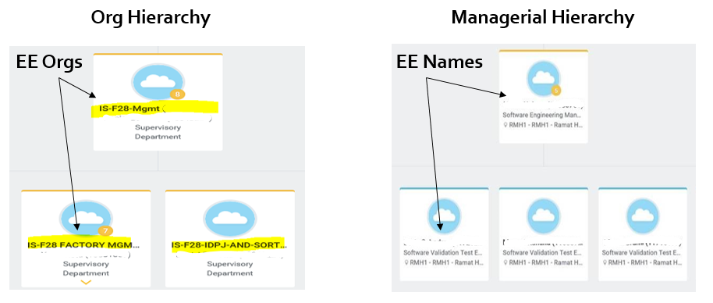
2 Parallel Hierarchy's
HR systems and Workday are based on 2 parallel Hierarchy’s: Org Hierarchy and Managerial Hierarchy:
In order to prepare to Focal clean up , please make sure to validate both Hierarchy’s are up to date.
Org Hierarchy is the one reflecting in the Focal Tool.

Slide 5
Managerial Hierarchy

Slide 6
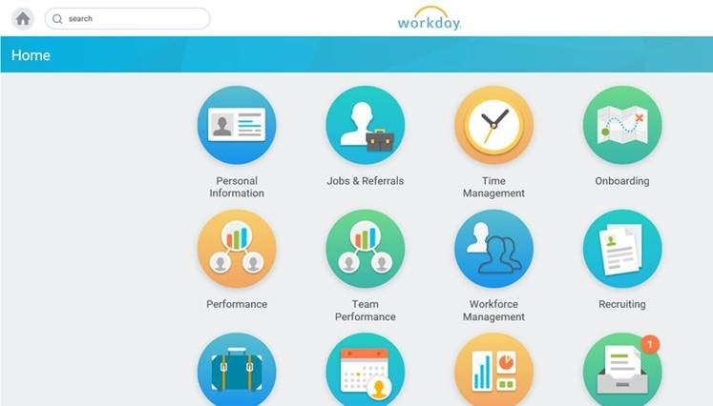
Managerial Hierarchy
How to check Managerial Hierarchy in Workday step by step
Log in to Workday (WD)
Click on Personal Information Icon

Slide 7
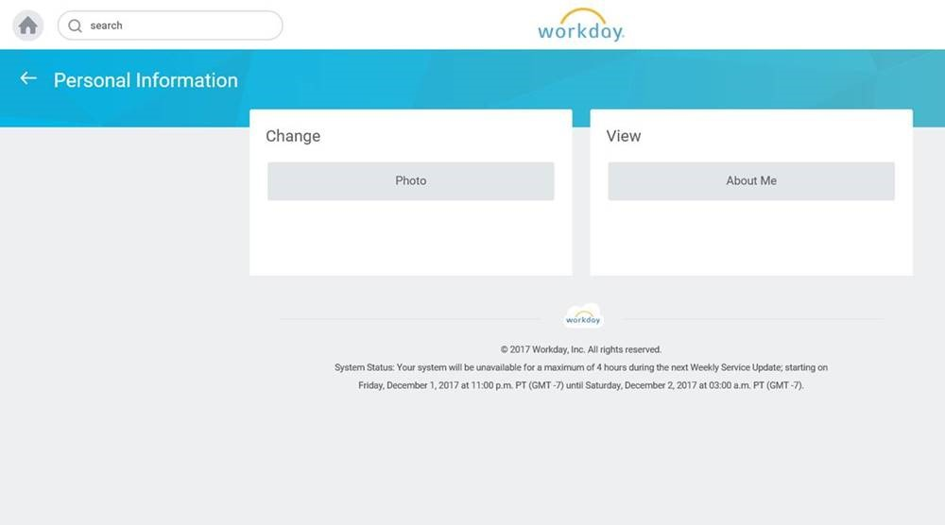
Managerial Hierarchy
Click “About me” to see your personal info

Slide 8
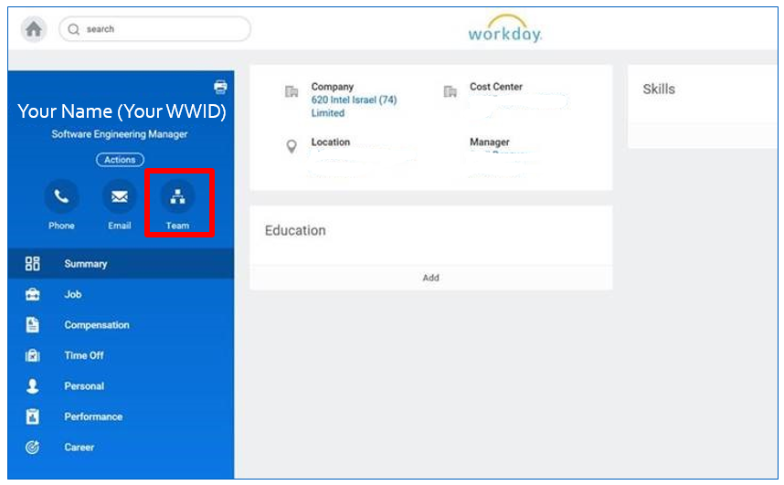
Managerial Hierarchy
Click “Team” to see your Org Chart

Slide 9
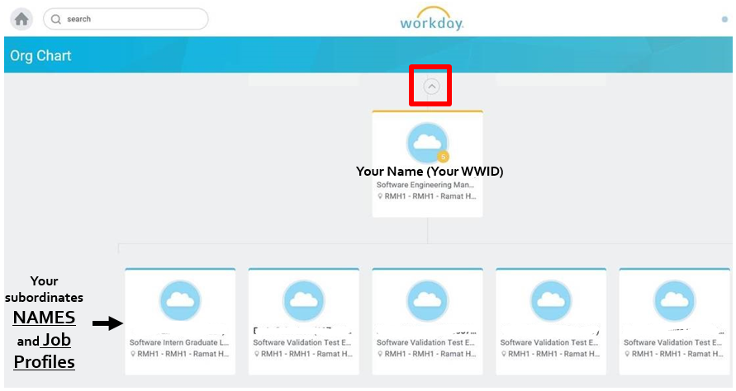
Managerial Hierarchy
Validate all subordinates report to you (if not, see slide 19)
Validate all Job Profiles are correct (if not, see slide 18)
Click on the small arrow above your name

Slide 10
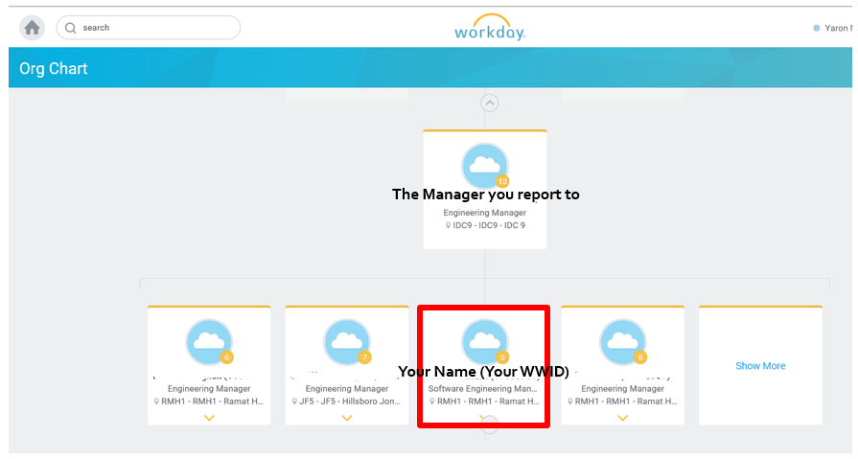
Managerial Hierarchy
Validate you report to the correct manager (if not, see slide 19)

Slide 11
Organization Hierarchy

Slide 12
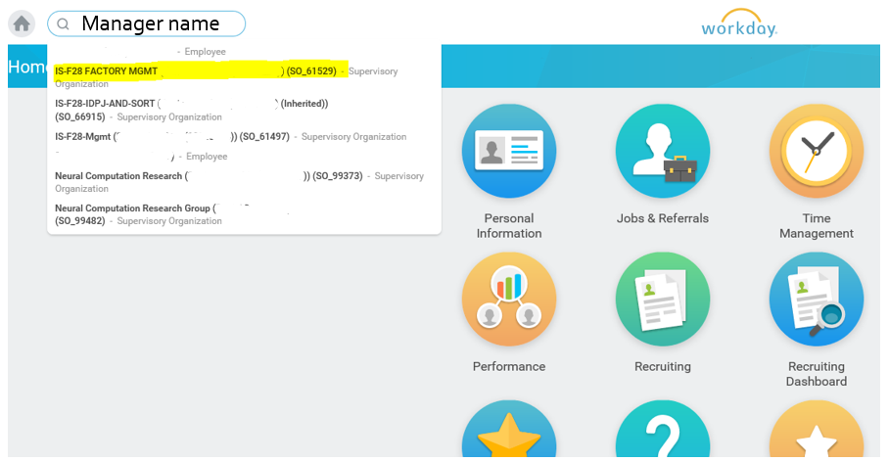
Org Hierarchy
How to check Org Hierarchy in Workday step by step
Log in to Workday (WD)
On the Search box, write Manager Name / WWID and choose the option of supervisory organization (marked in yellow).

Slide 13
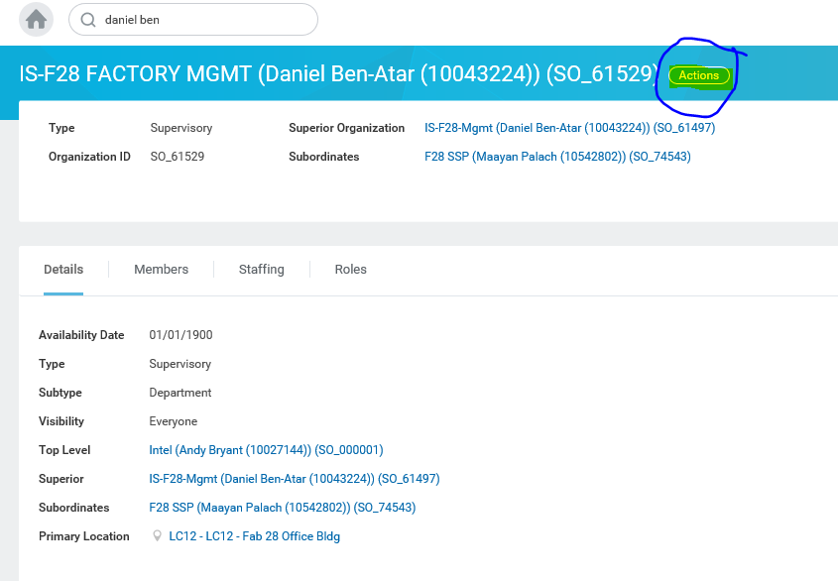
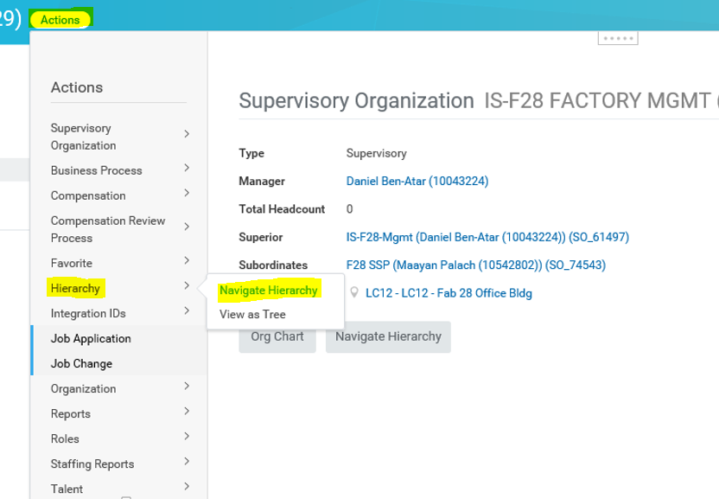
On the Organization page click Actions > Hierarchy > Navigate Hierarchy
Org Hierarchy

Slide 14
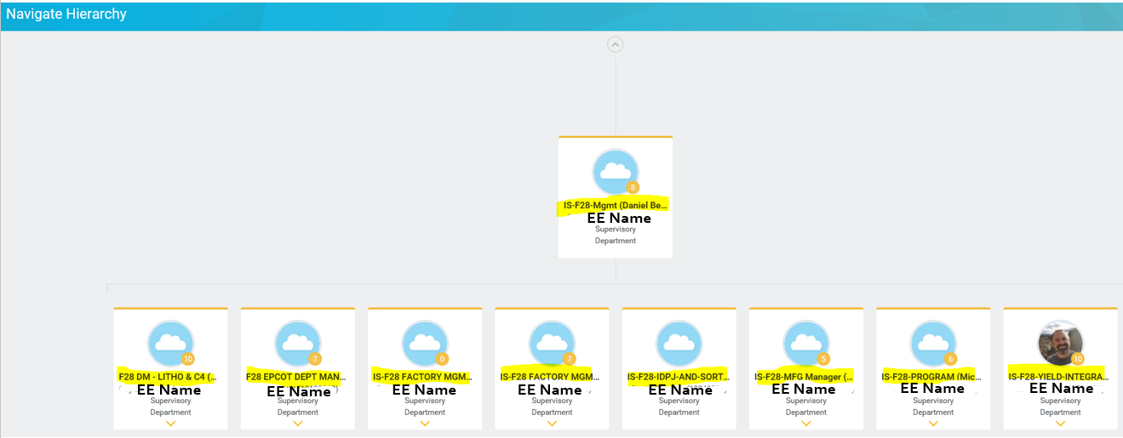
Validate all organization hierarchy (all Org Units) are correct (if not, see slides 15, 16, 20):
To make sure you watch the Org hierarchy and not the Managerial hierarchy, notice that the Org Units names appear above Employees’ names (that have been deleted in this picture)

Slide 15
Org Unit Changes
Managers might own more than one organization. Please make sure to validate them all.
In case you notice incorrect data, for example:
Old not active Org Unit
Incorrect Org Unit
Missing Org Unit
Etc.
please fix it by submitting Supervisory Organization Change Request form (See next slide)
In order to change a small number of employees’ details, there is no need in submitting the form. Changes can be made manually (see slide 20).

Slide 16
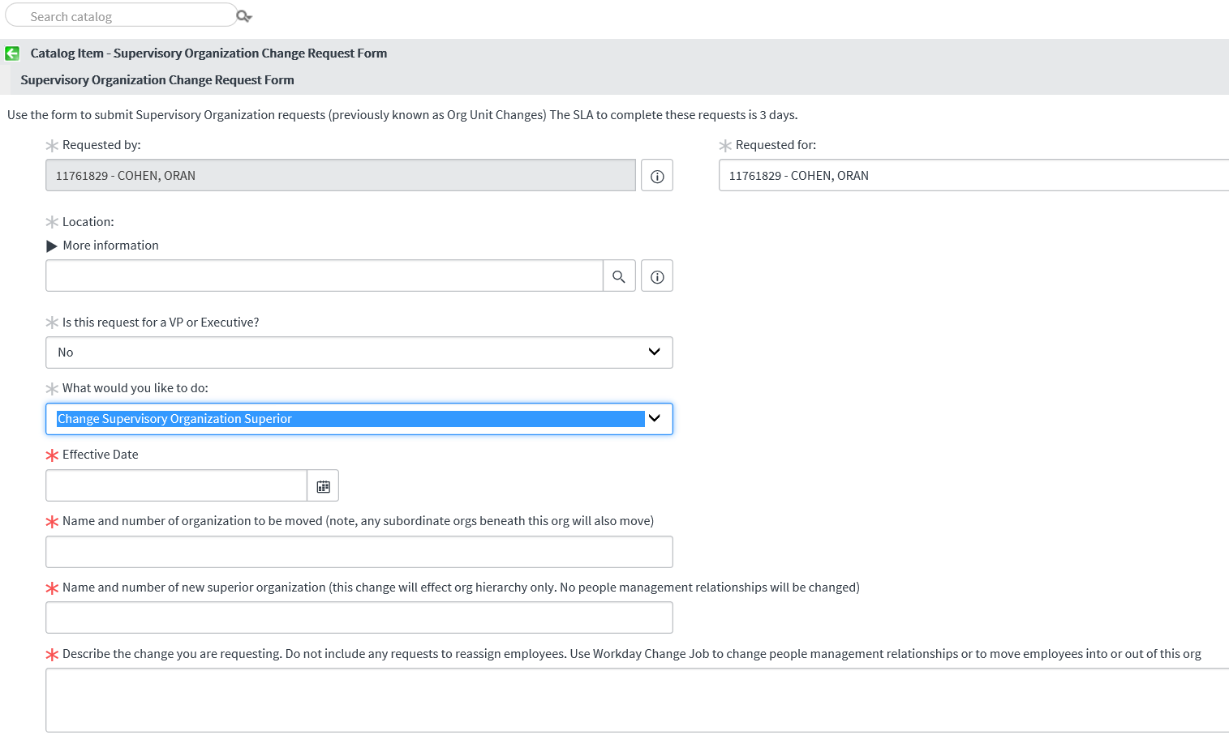
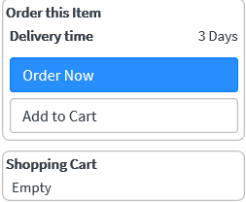
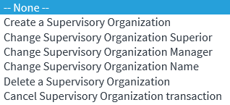
Org Unit Changes
Fill in all fields with the correct data, and click Order Now
Select the requested action from the list:
Notice 3 days SLA!

Slide 17
Changes per Single Employee - Job Profile - Manager - Supervisory Org

Slide 18
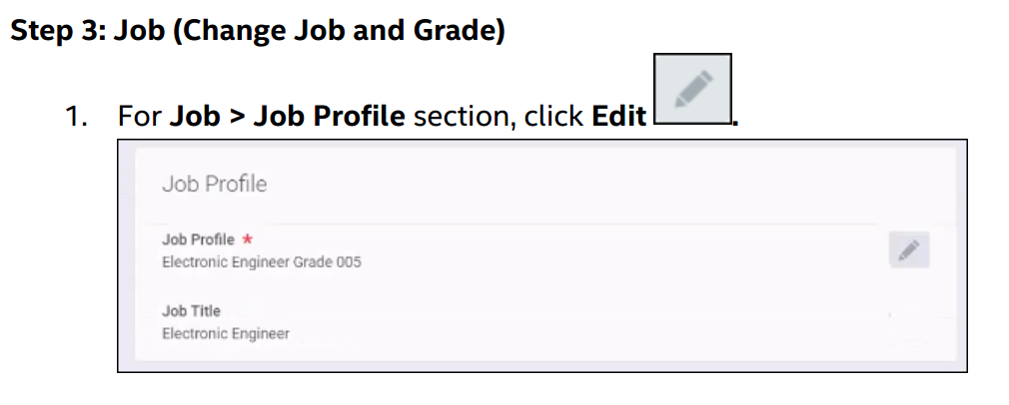
Changing your Employee Job Profile
Click the attached Job Aid and follow steps carefully:
Relevant section from Job Aid for Job Profile change is as follows:

Slide 19
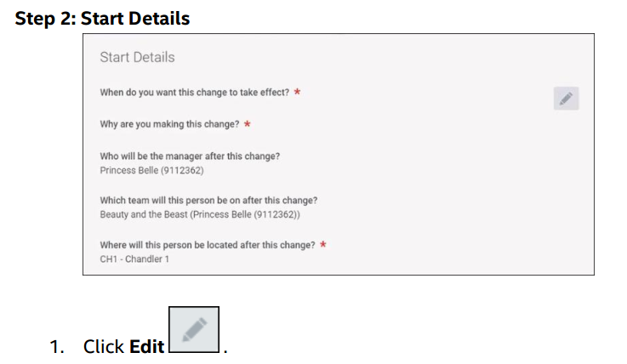
Changing your Employee Manager
Click the attached Job Aid and follow steps carefully:
Relevant section from Job Aid for Manager change is as follows:

Slide 20
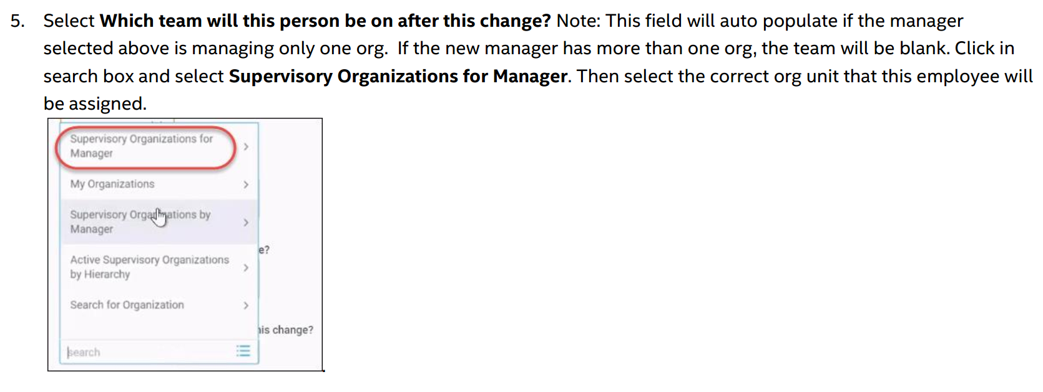
Changing your Employee Supervisory Org
Click the attached Job Aid and follow steps carefully:
Relevant section from Job Aid for Supervisory Org change is as follows:

Slide 21
Notes
Make sure to complete clean up till December 15th for the information to be reflected in the focal tool.
Internal transfer – note: the receiving manager has to approve the move through an email sent to his Workday inbox (in WD)
If you have any further questions regarding the process please contact your HRBP or Get HR Help

